Slide 1
Instructor Materials Chapter 6: Windows Configuration & Management
IT Essentials v6.0
Notes:
Cisco Networking Academy Program
IT Essentials
Chapter 6: Windows Configuration and Management

Slide 2
Instructor Materials - Chapter 6 Planning Guide
This PowerPoint is divided in two parts:
Instructor Planning Guide
Information to help you become familiar with the chapter
Teaching aids
Instructor Class Presentation
Optional slides that you can use in the classroom
Begins on slide #15
Note: Remove the Planning Guide from this presentation before sharing with anyone.
Notes:
2

Slide 3
ITE 6.0 Planning Guide
Chapter 5: Windows Configuration and Management
Notes:
ITE 6.0 Planning Guide
Chapter 6: Windows Configuration and Management

Slide 4
Chapter 6: Activities
What activities are associated with this chapter?
Page Number | Activity Type | Activity Name
6.1.1.5 | Lab | Task Manager in Windows 8
6.1.1.5 | Lab | Task Manager in Windows 7 and Vista
6.1.1.9 | Lab | Install Third-Party Software in Windows 8
6.1.1.9 | Lab | Install Third-Party Software in Windows 7 and Vista
6.1.2.3 | Lab | Create User Accounts in Windows 8
6.1.2.3 | Lab | Create User Accounts in Windows 7 and Vista
6.1.2.5 | Lab | Configure Browser Settings in Windows 8
Notes:
4

Slide 5
Chapter 6: Activities (Cont.)
What activities are associated with this chapter?
Page Number | Activity Type | Activity Name
6.1.2.5 | Lab | Configure Browser Settings in Windows 7 and Vista
6.1.2.12 | Lab | Manage Virtual Memory in Windows 8
6.1.2.12 | Lab | Manage Virtual Memory in Windows 7 and Vista
6.1.2.14 | Lab | Device Manager in Windows 8
6.1.2.14 | Lab | Device Manager in Windows 7 and Vista
6.1.2.16 | Lab | Regional and Language Options in Windows 8
6.1.2.16 | Lab | Regional and Language Options in Windows 7 and Vista
Notes:
5

Slide 6
Chapter 6: Activities (Cont.)
What activities are associated with this chapter?
Page Number | Activity Type | Activity Name
6.1.3.6 | Lab | Monitor and Manage System Resources in Windows 8
6.1.3.6 | Lab | Monitor and Manage System Resources in Windows 7 and Vista
6.1.4.2 | Lab | Hard Drive Maintenance in Windows 8
6.1.4.2 | Lab | Hard Drive Maintenance in Windows 7 and Vista
6.1.4.4 | Lab | Manage System Files in Windows
6.1.5.2 | Video | Common Windows CLI Commands
6.1.5.2 | Video | Log User Access
Notes:
6

Slide 7
Chapter 6: Activities (Cont.)
What activities are associated with this chapter?
Page Number | Activity Type | Activity Name
6.1.5.4 | Lab | Common Windows CLI Commands
6.1.5.6 | Lab | System Utilities in Windows
6.3.1.2 | Lab | Manage the Startup Folder in Windows 8
6.3.1.2 | Lab | Manage the Startup Folder in Windows 7 and Vista
6.3.1.5 | Lab | Task Scheduler in Windows 8
6.3.1.5 | Lab | Task Scheduler in Windows 7 and Vista
6.3.1.7 | Lab | System Restore in Windows 8
Notes:
7

Slide 8
Chapter 6: Activities (Cont.)
What activities are associated with this chapter?
Page Number | Activity Type | Activity Name
6.3.1.7 | Lab | System Restore in Windows 7 and Vista
6.3.1.9 | Video | Restore Points
6.3.1.9 | Video | Backup Tool
Notes:
8

Slide 9
Chapter 6: Assessment
Students should complete Chapter 6, “Assessment” after completing Chapter 6.
Quizzes, labs, Packet Tracers and other activities can be used to informally assess student progress.
Notes:
9

Slide 10
Chapter 6: Best Practices
Prior to teaching Chapter 6, the instructor should:
Complete Chapter 6, “Assessment.”
The goal of this chapter is to understand basic Windows maintenance and configuration.
It is important that students understand the GUI differences between Windows 7 & Vista and Windows 8.x; Start Screen Vs. Start Menu, the presence or absence of the Start Button, Win8.x search tool and Charms bar.
Make sure to focus on the fact that most Windows 7 & Vista tools were kept in Windows 8.x but may have different names or locations.
Make sure students understand how to use a search engine to find the location of tools in Windows 8.x.
Notes:
10

Slide 11
Chapter 6: Best Practices (Cont.)
This chapter also introduces the concept of Virtualization. Make sure students understand that VMs are independent from each other; each VM is a computer in its own right.
Make sure difference between Type 1 and 2 virtualization is well understood.
It should also be clear that the number of supported VMs depends on the host’s resources.
Notes:
11

Slide 12
Chapter 6: Additional Help
For additional help with teaching strategies, including lesson plans, analogies for difficult concepts, and discussion topics, visit the ITE Community at community.netacad.net.
If you have lesson plans or resources that you would like to share, upload them to the ITE Community in order to help other instructors.
Notes:
12

Slide 13
Chapter 6: Topics in chapter that are not found in the CompTIA A+ 220-901 Certification
This slide lists content included in this chapter that is NOT listed in the CompTIA A+ 220-901 blueprint. Instructors could skip these sections; however, they should provide additional information and fundamental concepts to assist the student with the topic.
All content in Chapter 6 is aligned to the certification.
Notes:
13

Slide 14


Slide 15
Chapter 6: Windows Configuration and Management
IT Essentials v6.0
Notes:
Cisco Networking Academy Program
IT Essentials
Chapter 6: Windows Configuration and Management

Slide 16
Chapter 6 - Sections & Objectives
6.1 The Windows GUI and Control Panel
Perform routine system management tasks with common Microsoft Windows tools.
6.2 Client-Side Virtualization
Configure virtualization on a computer.
6.3 Common Preventive Maintenance Techniques for Operating Systems
Use common preventive maintenance techniques for Microsoft Windows operating systems.
6.4 Basic Troubleshooting Process for Operating Systems
Explain how to troubleshoot Microsoft Windows operating systems.
6.5 Chapter Summary
Notes:
16

Slide 17
6.1 Windows Desktop, Tools, and Applications
Notes:
Cisco Networking Academy Program
IT Essentials
Chapter 6: Windows Configuration and Management

Slide 18

The Windows GUI and Control Panel Windows Desktop, Tools and Applications
Windows Desktop
A graphical representation of the workspace, often called GUI.
The desktop has icons, toolbars, and menus to manipulate files.
Windows 8 introduced a new desktop that uses tiles.
Desktop Properties
The Windows desktop is highly customizable.
Possible customizations include: re-arrange titles, change colors and sounds, modify screen resolution.
Start Menu
Allow users to manage programs, search the computer, and manipulate running applications.
The Start Menu can accessed by clicking the Windows icon.
Microsoft removed the Start Menu from Windows 8 but added back a limited version of it in Windows 8.1.
Notes:
6.1 The Windows GUI and Control Panel
6.1.1 – Windows Desktop, Tools and Applications

Slide 19
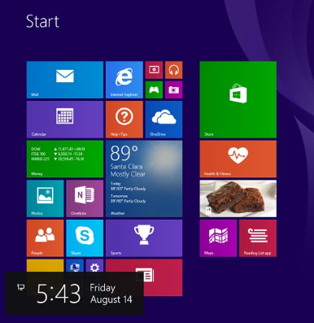
The Windows GUI and Control Panel Windows Desktop, Tools and Applications (Cont.)
Task Manager
Allows for the management of all applications running on the computer.
While presenting essentially the same information, Windows 8 has different tabs than Windows 7 & Vista.
Computer and Windows Explorer
File Explorer and Windows Explorer are similar file manager applications.
This PC and Computer features grant access to various drives.
Windows Libraries
Allows for easy organization of content; no need to move files.
Presents content from different locations in the same folder.
Install and Uninstall Applications
The installation process copies all necessary files to the proper disk location.
Setup.exe usually starts Windows installation processes.
The uninstall process removes the application and its related files.
Notes:
6.1 The Windows GUI and Control Panel
6.1.1 – Windows Desktop, Tools and Applications (Cont.)

Slide 20
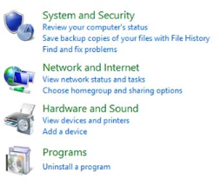
The Windows GUI and Control Panel Control Panel Utilities
Introduction to Control Panel Utilities
Centralizes the settings for many features.
Settings are categorized in utilities, or small programs.
User Accounts
Allows for account management.
UAC monitors programs and issues alerts upon system threating actions.
Internet Options
Allows for configuring Windows Internet settings.
Internet Options tabs are General, Security, Privacy, Content, Connections, Programs, Advanced.
Display Settings
Allows for configuring video-related settings.
Screen resolution, orientation, single/multiple displays are a few of the settings available under Display Settings.
Notes:
6.1 The Windows GUI and Control Panel
6.1.2 – Control Panel Utilities

Slide 21
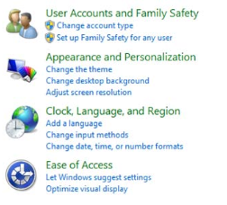
The Windows GUI and Control Panel Control Panel Utilities (Cont.)
Folder Options
Allows for configuring folder-related settings.
Allows for adjusting the behavior of folder browsing, how files are opened and displayed and more.
Action Center
Centralized location to view alerts that help keep Windows running smoothly.
Divided into Security and Maintenance sections.
Messages highlighted in red should addressed quickly; yellow-highlighted items indicate recommended tasks.
Windows Firewall
Helps prevent malicious attacks to the computer.
Allows for adjusting firewall settings for home, work or public networks.
Firewall settings include allowing a specific program through the firewall, turning the firewall on or off and managing firewall notifications.
Notes:
6.1 The Windows GUI and Control Panel
6.1.2 – Control Panel Utilities (Cont.)

Slide 22
The Windows GUI and Control Panel Control Panel Utilities (Cont.)
Power Options
Allows for adjusting power consumption.
Power plans can be customized to control how the computer and its components use power.
System Utility
Acts as a system information hub.
Allows users to view basic system information, access tools, and configure advanced system settings.
Device Manager, Devices and Printers and Sound
Device Manager provides a list of all the devices installed in the computer and their statuses.
Device Manager is a useful troubleshooting tool.
Devices and Printers displays devices connected to the computer through a port or network connection.
The Sound utility allows for configuring audio devices or changing the sound scheme of the computer.
Notes:
6.1 The Windows GUI and Control Panel
6.1.2 – Control Panel Utilities (Cont.)

Slide 23
The Windows GUI and Control Panel Control Panel Utilities (Cont.)
Region, Programs and Features and Troubleshooting
Region (Win8) allows for changing the format of numbers, currencies, dates, and time.
Language (Win8) allows for changing the primary language or install an additional language.
In Win 7 & Vista both tools are combined into the Region and Language tool.
Programs and Features allows for uninstalling programs or for changing a program's configuration.
The Troubleshooting tool has a number of built-in scripts to identify and solve problems.
HomeGroup and Network and Sharing Center
HomeGroup allows Windows computers to share resources.
HomeGroup is available on Windows 7 or higher.
Network and Sharing Center allows for configuring and reviewing all network operations in a Windows computer.
Notes:
6.1 The Windows GUI and Control Panel
6.1.2 – Control Panel Utilities (Cont.)

Slide 24
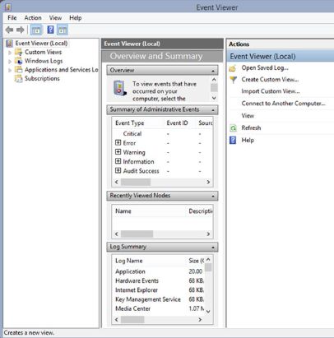
The Windows GUI and Control Panel Administrative Tools
Computer Management
Allows for the management of many aspects of the computer and remote computers in one tool.
Provides access to a number of utilities: Task Scheduler, Event Viewer, Shared Folders, Local Users and Groups, Performance, Device Manager and Disk Management.
Event Viewer
Logs the history of application, security, system events.
These log files are a crucial when troubleshooting.
Services
Allows for the management of all the services on your computer and remote computers.
Services can be configured to start automatically, automatically with delay, or manually.
Notes:
6.1 The Windows GUI and Control Panel
6.1.3 – Administrative Tools

Slide 25
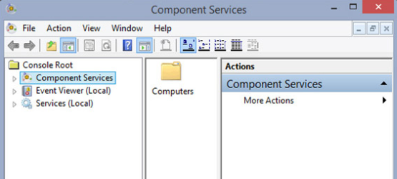
The Windows GUI and Control Panel Administrative Tools (Cont.)
System Configuration
Used to identify problems that keep Windows from starting correctly.
Services and startup programs can be turned off to help troubleshooting.
Performance Monitor and Windows Memory Diagnostics
Displays an overview of the Performance Monitor and System Summary.
System Summary displays real-time information about the processors, disks, memory, and network usage.
System Summary displays detailed data about the resources currently in use.
Notes:
6.1 The Windows GUI and Control Panel
6.1.3 – Administrative Tools (Cont.)

Slide 26
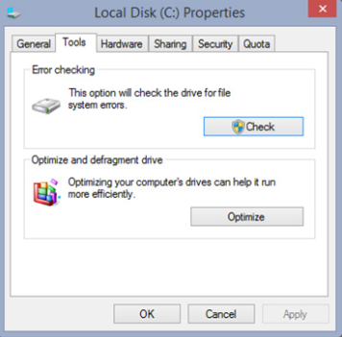
The Windows GUI and Control Panel Disk Defragmenter and Disk Error-Checking Tool
Disk Defragmenter and Disk Error-Checking Tool
Disk Defragmenter consolidates files for faster access.
SSDs do not need user-triggered defragmentation; the drive controller defrags as it writes to the disk.
Disk Error-Checking scans the hard drive for file structure or disk surface errors.
System Information
Combines information about software, drivers, hardware configurations, and computer components in one place.
Helpful for support personnel when troubleshooting and diagnosing a computer.
Notes:
6.1 The Windows GUI and Control Panel
6.1.4 – Disk Defragmenter and Disk Error-Checking Tool

Slide 27
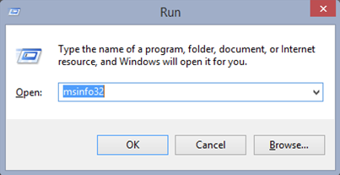
The Windows GUI and Control Panel Command Line Tools
Windows Command Line Interface
CLI is a text-based interface.
CLI can be useful when troubleshooting OS problems, especially if the GUI is inoperative.
System Utilities
Run Line utility allows for invoking a tool by typing its name; no need to find the icon and click it.
A few common tools include: COMMAND, DXDIAG, EXPLORER, MMC, MSINFO32, MSTSC, NOTEPAD, REGEDIT.
Notes:
6.1 The Windows GUI and Control Panel
6.1.5 – Command Line Tools

Slide 28
6.2 Client-Side Virtualization
Notes:
Cisco Networking Academy Program
IT Essentials
Chapter 6: Windows Configuration and Management

Slide 29
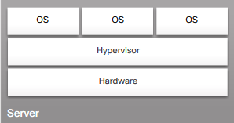
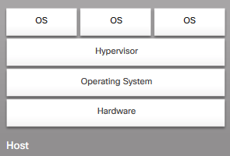
Client-Side Virtualization Purpose and Requirements of Virtualization
Purpose of Virtual Machines
Provides staff with critical resources.
Reduced computer hosting costs.
Provides access to tools not available on a specific OS.
Hypervisor: Virtual Machine Manager
The software that manages the VMs on a host machine.
Hypervisors allocate physical system resources to each virtual machine as needed.
Hypervisors can be Type 1 (native) or Type 2 (hosted).
Virtual Machine Requirements
All VMs have basic system requirements.
The host machine must have enough resources to meet all the VMs it hosts.
VMs are also susceptible to malicious attacks.
Notes:
6.2 Client-Side Virtualization
6.2.1 – Purpose and Requirements of Virtualization

Slide 30
6.3 Common Preventive Maintenance Techniques for Operating Systems
Notes:
Cisco Networking Academy Program
IT Essentials
Chapter 6: Windows Configuration and Management

Slide 31
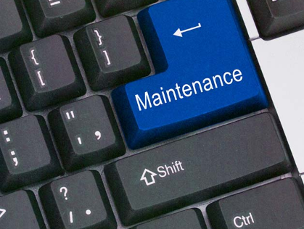
Common Preventive Maintenance Techniques for Operating Systems OS Preventive Maintenance Plan
Preventive Maintenance Plan Contents
The plan includes detailed information about the maintenance of all computers and network equipment.
Prioritizes mission critical equipment.
Includes installing service packs and various updates, disk backups and disk error checking.
Updates
Driver updates help ensure hardware optimal operation.
OS updates address security, performance and stability issues.
Firmware updates can enable new features and also improve hardware performance and stability.
Scheduling Tasks
Some preventive tasks can be configured to run at an assigned time.
Use either Windows Task Scheduler or the at command.
Notes:
6.3 Common Preventive Maintenance Techniques for Operating Systems
6.3.1 – OS Preventive Maintenance Plan

Slide 32
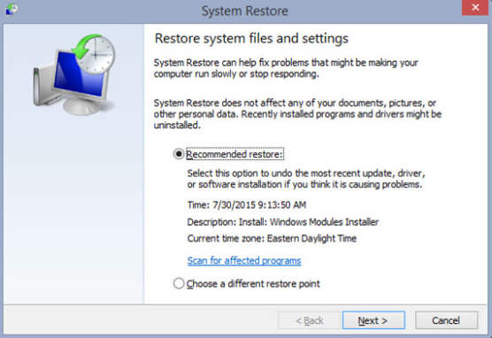
Common Preventive Maintenance Techniques for Operating Systems OS Preventive Maintenance Plan (Cont.)
Restore Points
Contain information about the OS, installed programs, and registry settings.
This information allows the computer to revert back to a previous operational state in case of failure.
Hard Drive Backup
Backup strategies are crucial.
If done properly, it is not necessary to back up all files.
Windows 8.1 includes File History.
Windows 7 and Vista include Backup and Restore.
Notes:
6.3 Common Preventive Maintenance Techniques for Operating Systems
6.3.1 – OS Preventive Maintenance Plan (Cont.)

Slide 33
6.4 Basic Troubleshooting Process for Operating Systems
Notes:
Cisco Networking Academy Program
IT Essentials
Chapter 6: Windows Configuration and Management

Slide 34
Basic Troubleshooting Process for Operating Systems Applying the Troubleshooting Process for Operating Systems
Identify the Problem
The first step in the troubleshooting process.
A list of open and closed-ended questions is useful.
Establish a Theory of Probable Cause
Based on the answers received, establish a theory probable cause.
A list of common problems can be useful.
Test the Theory to Determine Cause
Test your theories to determine the cause of the problem.
A list of quick procedures to common problems can help.
Establish a Plan of Action to Resolve the Problem and Implement the Solution
A plan of action is needed to solve the problem and implement a permanent solution.
Notes:
6.4 Basic Troubleshooting Process for Operating Systems
6.4.1 – Applying Troubleshooting Process for Operating Systems

Slide 35
Basic Troubleshooting Process for Operating Systems Applying the Troubleshooting Process for Operating Systems
Verify Full System Functionality and Implement Preventive Measures
It is important to perform a full system check.
If applicable, implement preventive measures to avoid future problem recurrences.
Document Findings, Actions and Outcomes
Findings, repairs and notes should be documented.
This log can be helpful for future reference.
Notes:
6.4 Basic Troubleshooting Process for Operating Systems
6.4.1 – Applying Troubleshooting Process for Operating Systems (Cont.)

Slide 36
Basic Troubleshooting Process for Operating Systems Common Problems and Solutions
Some OS problems are more common than others.
OS problems are usually caused by hardware, application or configuration issues.
A few common OS problems include:
OS locks up
The keyboard or mouse does not respond.
The OS will not start.
The computer displays a “BOOTMGR is missing” error after POST.
A service failed to start when the computer booted.
A device did not start when the computer booted.
The computer continually restarts without displaying the desktop.
The computer displays a black or blue screen of death.
Notes:
6.4 Basic Troubleshooting Process for Operating Systems
6.4.2 – Common Problems and Solutions

Slide 37
6.5 Chapter Summary
Notes:
Cisco Networking Academy Program
IT Essentials
Chapter 6: Windows Configuration and Management

Slide 38
Chapter Summary Summary
This chapter covered Windows configuration and management. As a technician, you should be skilled at installing, configuring, and troubleshooting an operating system. The following concepts from this chapter are important to remember:
Several different operating systems are available, and you must consider the customer’s needs and environment when choosing an OS.
The main steps in setting up a customer’s computer include preparing the hard drive, installing the OS, creating user accounts, and configuring installation options.
A GUI shows icons of all files, folders, and applications on the computer. A pointing device, such as a mouse, is used to navigate in a GUI desktop.
A CLI uses commands to complete tasks and navigate the file system.
With a virtual machine manager, system resources on a host computer can be allocated to run virtual machines. Virtual machines run operating systems, and using them can provide users with greater system functionality.
Preventive maintenance techniques help to ensure optimal performance of the OS. You should establish a backup strategy that allows for the recovery of data.
Some of the tools available for troubleshooting an OS problem include administrative tools, system tools, and CLI commands.
Notes:
6.5.1.1 - Summary

Slide 40


Slide 41
Chapter 6 New Terms and Commands
activex
at (command)
blocker
chkdsk
cli
ctrl
dxdiag
fat32
homegroup
hypervisor
linux
mmc
msconfig
mstsc
nas
ntfs
odbc
readyboost
regedit
region (tool)
soho
ssds
sshd
uac
uid
Notes:
New Terms and Commands

